Slide 1
EFFICIENT EDUCATIONAL RECOMMENDER SYSTEM USING TRANSFER LEARNING
GUIDED BY:
Ms. Mehbooba Shereef
PRESENTED BY:
Sona Sebastian-U2103200
Sreya S-U2103203
Susan Sara Joby-U2103205
Vaishnavi M-U2103212 S8 CSE GAMMA(2021-25)

Slide 2
CONTENTS
INTRODUCTION
PROBLEM STATEMENT
NOVELTY AND INNOVATIVENESS
SCOPE OF IMPLEMENTATION
LITERATURE REVIEW
METHODOLOGY
SYSTEM ARCHITECTURE
RESULT
FUTURE WORK
CONCLUSION
REFERENCES

Slide 3
INTRODUCTION
Our project focuses on evaluating the effectiveness of transfer learning in improving the performance of deep learning models. We implement and compare four different models across multiple datasets, analyzing changes in RMSE, MAE, and inference time per step. The aim is to demonstrate how transferring knowledge from a source domain can enhance model accuracy and efficiency in a target domain with limited data.

Slide 4
PROBLEM STATEMENT
Current recommendation systems struggle with efficiently adapting to new user preferences, lack personalized recommendations tailored to diverse student needs, and face challenges in improving accuracy over time without extensive retraining.

Slide 5
PURPOSE AND NEED
In today’s data-driven educational environment, students are often overwhelmed by the range of course options. A recommendation system, fine-tuned with course-specific data, can provide personalized suggestions in less time, helping students make informed decisions while improving their overall learning experience.

Slide 6
PROJECT OBJECTIVE
Fine-tune pre-trained models on course-specific data for accurate recommendations.
Analyze and Compare Machine Learning Models for Educational Recommendation
Investigate the Impact of Transfer Learning
Optimize Computational Efficiency

Slide 7
NOVELTY AND INNOVATIVENESS
Comprehensive Multi-Model Evaluation Applied transfer learning across four different models to assess generalizability.
Cross-Dataset Performance Analysis Tested on multiple datasets to study domain transfer effectiveness.
Speed vs. Accuracy Trade-off Exploration Highlighted inference time reduction (up to 80%) with minimal accuracy loss.
Real-Time Application Feasibility Achieved inference speeds as low as 2ms — suitable for time-sensitive tasks.
Unified Benchmarking Approach Compared RMSE, MAE, and Time/Step before and after transfer learning.

Slide 8
SCOPE OF IMPLEMENATION
Model Adaptability
Transfer learning enables rapid adaptation of models to new but related datasets with minimal retraining.
Real-Time Applications Optimized inference speed (as low as 2ms) supports deployment in time-critical systems.
Resource-Constrained Environments Reduced computational cost makes the models suitable for edge devices and low-power platforms.
Scalable Evaluation Framework Methodology can be extended to additional models, datasets, or domains for broader research.

Slide 9
LITERATURE SURVEY
PAPER | DATASET | METHODOLOGY | RESULT | ADVANTAGES | DISADVANTAGES
[1] Dynamic Graph Neural Network for Sequential Recommendation. (2022) | Amazon: three categories,AmazonCDs, Amazon-Games, Amazon-Beauty. MovieLens2:MoveLens-1M | User sequences are converted into dynamic graph, which contains the chronological order, time stamp of user item interactions | User sequences converted into a dynamic graph thereby using short and long term embeddings. | Captures Temporal User Behavior, efficiently handle dynamic changes | The complexity of processing large, evolving graph structures and training DGNNs.
[2] Transfer Learning With Time Series Data:A Systematic Mapping Study. (2021) | UCI HAR Dataset, MIT-BIH Arrhythmia Database, PhysioNet datasets Energy forecasting datasets | Reuse a pretrained model on new data by adjusting its weights to adapt to the target task. | fine-tuning was the most commonly used transfer learning approach in time series problems. | Simple to implement; leverages knowledge from the source domain;widely applicable. | May struggle with significant domain shifts;

Slide 10
LITERATURE SURVEY
PAPER | DATASET | METHODOLGY | RESULT | ADVANTAGES | DISADVANTAGES
[4] Making recommendations using transfer learning Xing Fang.(2020) | Amazon Review dataset (Electronics, Books, Movies, Music, Home & Kitchen categories)and IMDB Movie Review dataset | Used BERT and XLNet for review representation and fine-tuned it across source and target domain | Transfer learning improved performance across target domains in terms of accuracy. | Bidirectional context understanding and addresses the issue of data sparsity | Requires high computational resources for fine-tuning large models like BERT.
[3] Novel online Recommendation algorithm for Massive Open Online Courses (NoR-MOOCs) (2021) | Coco dataset | Used hypersphere-based embedding to map users and items on a high-dimensional sphere, leveraging angular similarity for improved recommendations. | Improved recommendations with low rmse values. | able to provide personalized course recommendations to users. | -Parameter Sensitivity: as the generation size, radius of hyper-spheres. Cold start problems.

Slide 11
PROPOSED METHOD
Applied transfer learning across four distinct deep learning models (Model 1 to Model 4).
Trained base models on source datasets, then fine-tuned on target datasets.
Evaluated model performance using RMSE, MAE, and Time/Step before and after transfer learning.
Conducted cross-dataset and cross-model comparisons to identify performance patterns.
Designed a benchmarking framework for analyzing accuracy-efficiency trade-offs.

Slide 12
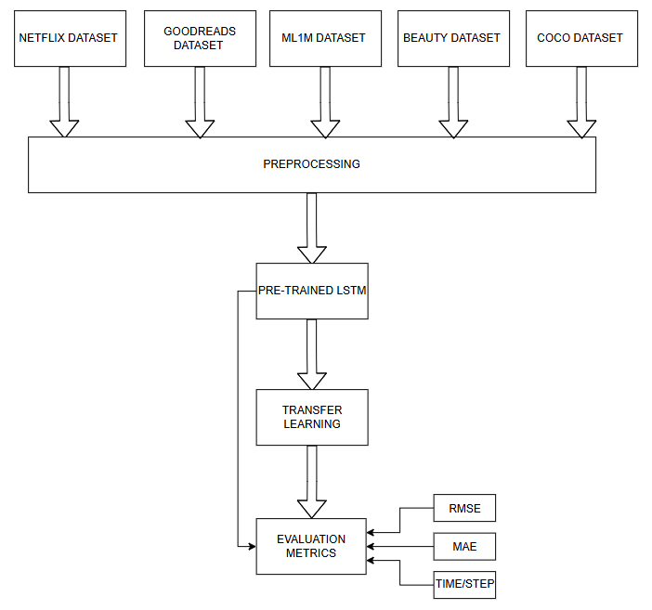
SYSTEM ARCHITECTURE
LSTM-1

Slide 13

FNN

Slide 14
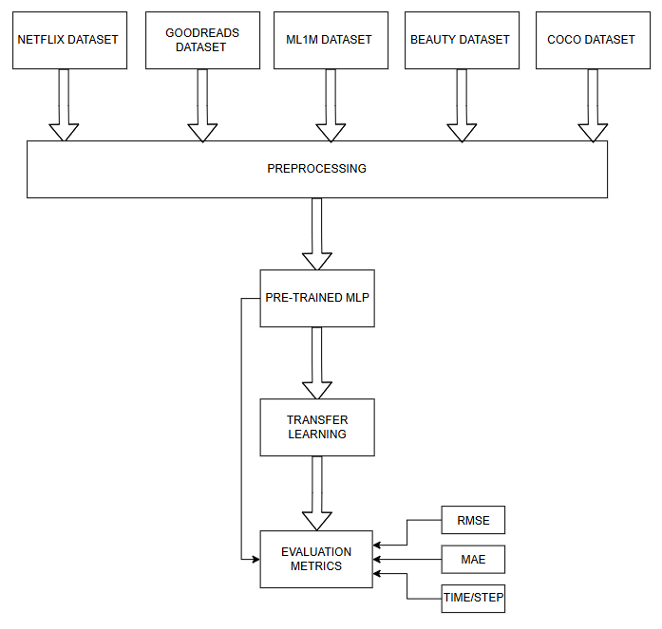
MLP

Slide 15
LSTM-2

Slide 16
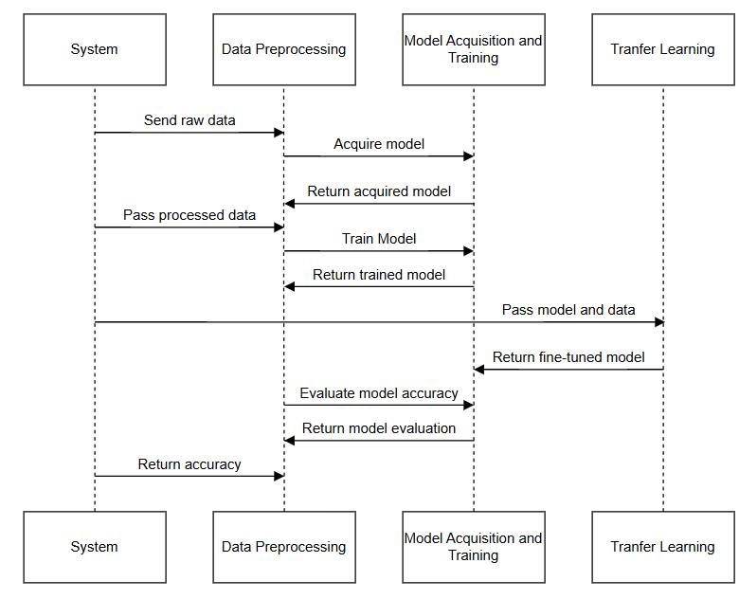
SEQUENCE DIAGRAM

Slide 17
MODULES
MODULE-1 Data Preprocessing
Tasks:
Data Cleaning: Handle missing values, remove duplicates, and clean noisy text (e.g., typos in reviews or course descriptions). .
For numerical data, detect and correct errors such as impossible values or inconsistencies. Additionally, ensure that each record is unique and relevant by filtering out any irrelevant or redundant data entries.
Normalization: Scale data where necessary (e.g., rating scores).

Slide 18
MODULE-2 Model Acquisition
Objective: To acquire a predictive model using a multivariate models.
Feature Interactions: Handles multiple correlated variables like learner ratings, leanrer ID, and course ID.

Slide 19
Module-3 Model Training
Objective: Utilize a pre-trained LSTM model to generate predictions based on the project dataset, without modifying the model's existing weights or structure.
Training Strategy:
1.Using a Pre-Trained Model:
The LSTM model was pre-trained on several datasets to capture general temporal dependencies and patterns related to similar tasks.
The pre-trained model serves as a ready-to-use tool.
2.Dataset Integration:
The project dataset, containing fields like learner ID, course ID, learner rating, course ratings, was formatted to align with the input requirements of the pre-trained models.
Sequential data (e.g., learner-course interactions) was structured in time-series format to match the multivariate input expectations. Datasets taken: Netflix, Goodreads, ML1M, COCO, Beauty

Slide 20
3.Evaluation:
The model predictions were evaluated using the following metrics:
Root Mean Square Error (RMSE): Assess the magnitude of prediction errors.
Mean Absolute Error (MAE): Measure the average prediction error.
Time/step: Measure the time taken for each epoch
Output: the model was found to produce fairly accurate predictions with the input of data with minimal RMSE.

Slide 21
Module-4 Transfer learning
Transfer Learning in Educational Recommender System:
Transfer learning leverages a pre-trained model to solve a new, but related task, reducing training time and computational effort.
In this project, several pre-trained models are used, which have already been trained on a large dataset of educational data.
The model is fine-tuned using our specific dataset (user-course interactions), adapting it to make relevant course recommendations

Slide 22
How Transfer Learning is Applied:
The pre-trained LSTM model is used as the starting point, which has already learned patterns from general educational data.
Fine-tuning is performed by retraining the model on our specific dataset to tailor it for course recommendations.
The model’s last layer alone is trained to specialize in making accurate predictions for the given task with our dataset.

Slide 23
Module-5 Comparison
Metric-Based Evaluation Compared RMSE, MAE, and Time/Step across all four models before and after applying transfer learning.
Visual Analysis Bar charts and plots used to highlight performance trends and trade-offs across multiple datasets.
Tabular Comparison Summarized quantitative differences showing how transfer learning impacted each model’s efficiency and accuracy.
Performance Insights
Some models achieved significant inference speedups (up to 80%)
Accuracy improved in certain cases; in others, slight degradation revealed domain transfer limitations
Cross-Model Trends Identified which models benefited most from transfer learning and which showed limited gains — supporting deeper architectural insights.

Slide 24
WORK BREAKDOWN AND RESPONSIBILITIES
Sona Sebastian LSTM-2 and FNN: Model training and transfer learning
Sreya S
LSTM-1 and MLP:
Model training and transfer learning
Susan Sara Joby
Data collection and preprocessing
Vaishnavi M
Model acquisition and comparison

Slide 25
HARDWARE AND SOFTWARE REQUIREMENTS
Software
Python 3.x, Jupyter Notebook / VS Code / Google Colab
Libraries: TensorFlow / PyTorch, NumPy, Pandas, Scikit-learn, Matplotlib
Hardware
System with at least 8 GB RAM (16 GB preferred for parallel processing)
GPU (NVIDIA 4GB+ VRAM) if not using cloud; else Google Colab Free/Pro is enough
Stable internet connection (for model downloads and cloud-based execution)

Slide 26
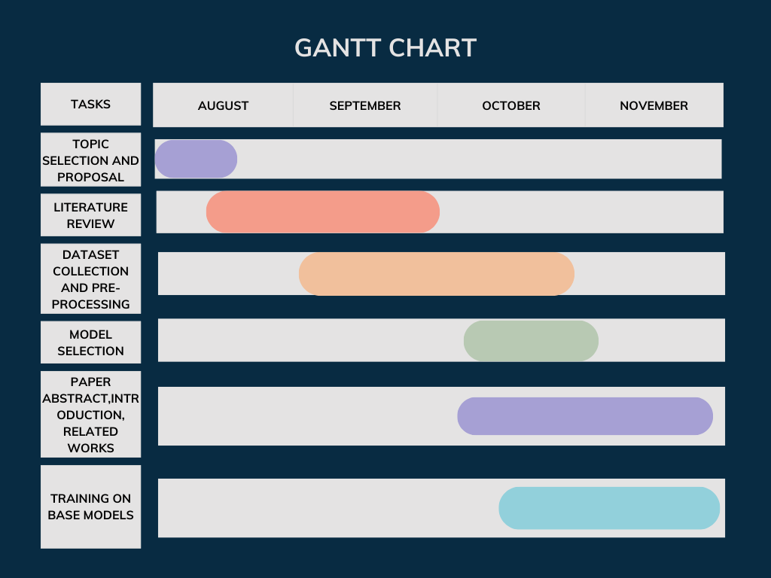
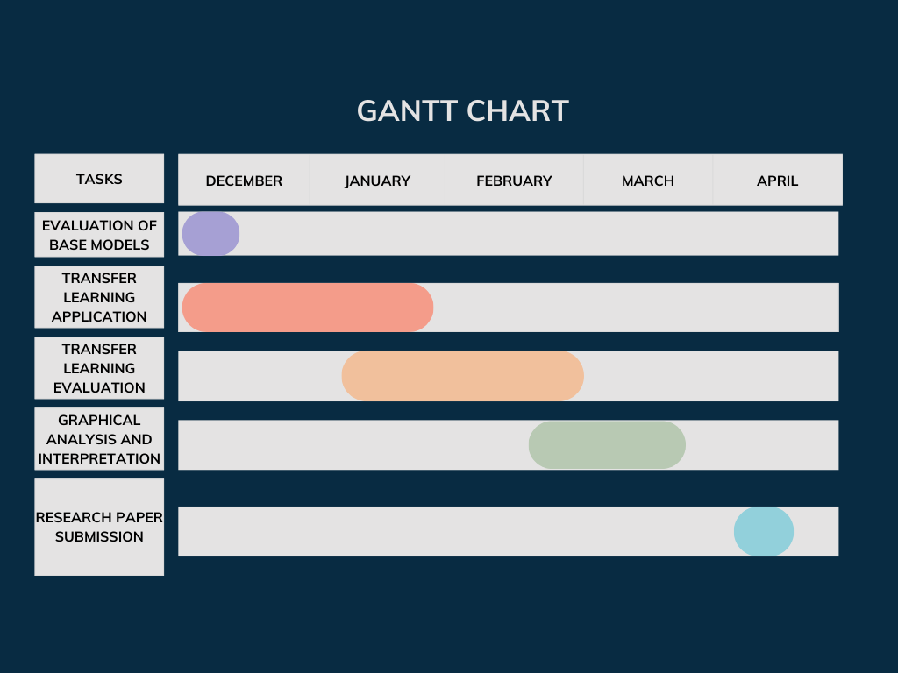
GANTT CHART

Slide 27
RISKS AND CHALLENGES
Performance Degradation Due to Domain Shift If the source domain (pretraining data) is significantly different from the target domain (e.g., educational data), the model may fail to generalize well, leading to poor performance.
Impact of Data Sparsity Limited labeled data in the target domain can make it difficult for the model to learn task-specific patterns, reducing the effectiveness of transfer learning.
Overfitting During Fine-Tuning Transfer learning with small datasets can cause the model to overfit to the target data instead of generalizing.

Slide 28
RESULT
Improved Inference Time Reduced model execution time from up to 10ms to just 2ms per step using transfer learning.
Improved Accuracy
On applying transfer learning, the model performed efficiently on minimal datastet
Accuracy vs. Efficiency Trade-off Analysis Evaluated how transfer learning affects RMSE and MAE across different models and datasets.
Cross-Model Performance Comparison Identified which models (1–4) benefit most from transfer learning in terms of both speed and accuracy.
Reusable Evaluation Framework Established a benchmarking approach using RMSE, MAE, and Time/Step for future research.
Deployment-Ready Optimized Models Fine-tuned models are efficient and suitable for real-time and low-resource environments

Slide 29
DATASETS | MODEL 1(LSTM) | MODEL 2 (FNN) | MODEL 3(MLP) | MODEL 4(LSTM)
DATASET 1 | Before: RMSE:0.8851 MAE:0.7301 TIME/STEP:11ms After: RMSE:0.9876 MAE:0.7754 TIME/STEP:3ms | Before: RMSE:0.97 MAE:0.77 TIME/STEP:656us After: RMSE:0.97 MAE:0.77 TIME/STEP:509us | Before: RMSE:0.96 MAE:0.79 TIME/STEP:847us After: RMSE:0.96 MAE:0.78 TIME/STEP:491us | Before: RMSE:0.84 MAE:0.65 TIME/STEP:10ms After: RMSE:0.93 MAE:0.74 TIME/STEP:2ms
DATASET 2 | Before: RMSE:0.3491 MAE:0.2456 TIME/STEP:10ms After: RMSE:0.5373 MAE:0.4293 TIME/STEP:3ms | Before: RMSE:0.68 MAE:0.34 TIME/STEP:658us After: RMSE:0.96 MAE:0.70 TIME/STEP:437us | Before: RMSE:0.37 MAE:0.17 TIME/STEP:526us After: RMSE:0.41 MAE:0.25 TIME/STEP:536us | Before: RMSE:0.63 MAE:0.35 TIME/STEP:5ms After: RMSE:0.73 MAE:0.57 TIME/STEP:2ms
COMPARISON OF RESULTS BEFORE AND AFTER APPLYING TRANSFER LEARNING

Slide 30
COMPARISON OF RESULTS BEFORE AND AFTER APPLYING TRANSFER LEARNING
DATASET 3 | Before: RMSE:1.721 MAE:1.42966 TIME/STEP:10ms After: RMSE:2.0208 MAE:1.9150 TIME/STEP:3ms | Before: RMSE:0.89 MAE:0.76 TIME/STEP:742us After: RMSE:0.93 MAE:0.83 TIME/STEP:669us | Before: RMSE:1.68 MAE:1.48 TIME/STEP:860us After: RMSE:0.54 MAE:0.39 TIME/STEP:417us | Before: RMSE:0.97 MAE:0.86 TIME/STEP:7ms After: RMSE:0.98 MAE:0.92 TIME/STEP:2ms
DATASET 4 | Before: RMSE:1.228 MAE:1.021 TIME/STEP:11ms After: RMSE:1.0461 MAE:0.8397 TIME/STEP:3ms | Before: RMSE:0.97 MAE:0.79 TIME/STEP:617us After: RMSE:1.02 MAE:0.85 TIME/STEP:556us | Before: RMSE:1.13 MAE:0.95 TIME/STEP:692us After: RMSE:1.14 MAE:0.95 TIME/STEP:506us | Before: RMSE:1.15 MAE:0.93 TIME/STEP:6ms After: RMSE:1.00 MAE:0.83 TIME/STEP:2ms

Slide 31
COMPARISON OF RESULTS BEFORE AND AFTER APPLYING TRANSFER LEARNING
DATASET 5 | Before: RMSE:1.0269 MAE:0.822 TIME/STEP:10ms After: RMSE:1.0865 MAE:0.8981 TIME/STEP:3ms | Before: RMSE:0.78 MAE:0.62 TIME/STEP:737us After: RMSE:0.78 MAE:0.62 TIME/STEP:659us | Before: RMSE:0.94 MAE:0.71 TIME/STEP:802us After: RMSE:1.28 MAE:1.02 TIME/STEP:564us | Before: RMSE:0.82 MAE:0.66 TIME/STEP:7ms After: RMSE:1.2 MAE:1.06 TIME/STEP:2ms

Slide 32
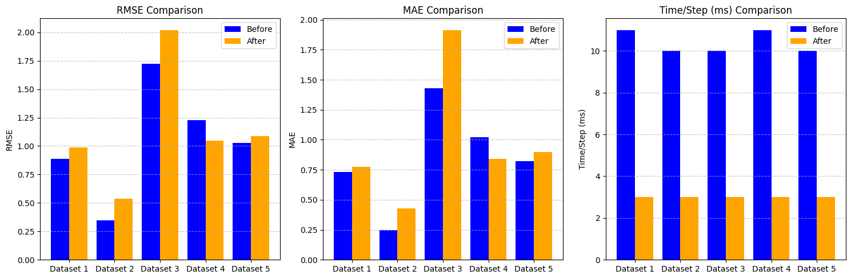
MODEL-1(LSTM)

Slide 33
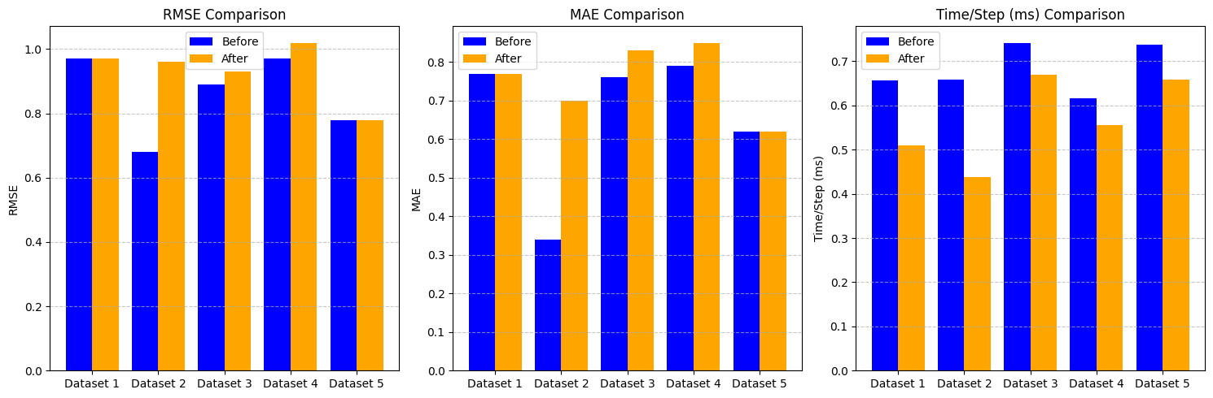
MODEL-2(FNN)

Slide 34
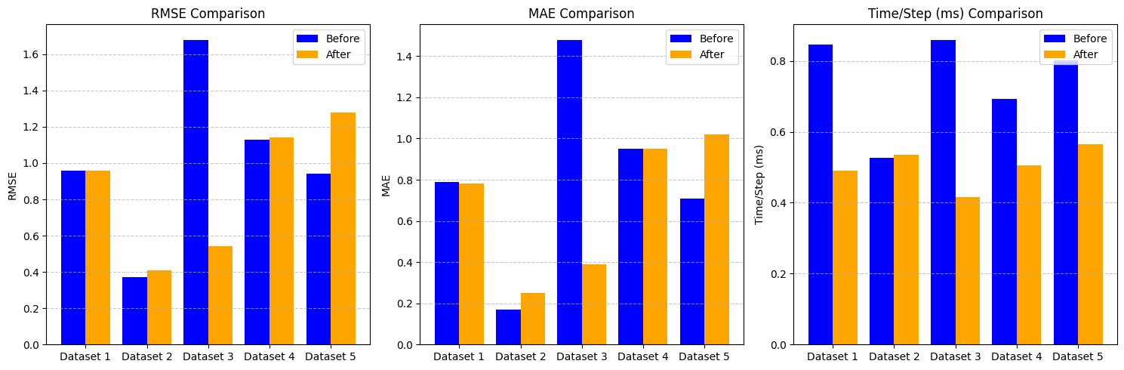
MODEL-3(MLP)

Slide 35
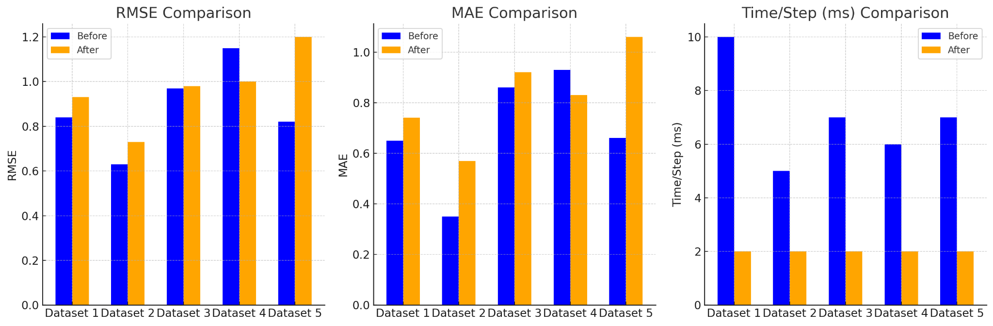
MODEL-4(LSTM)

Slide 36
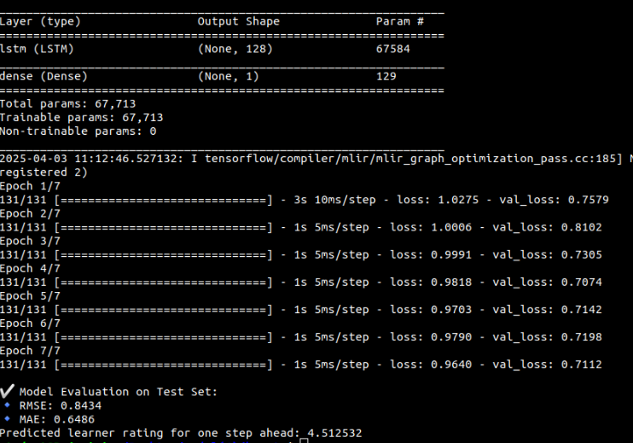
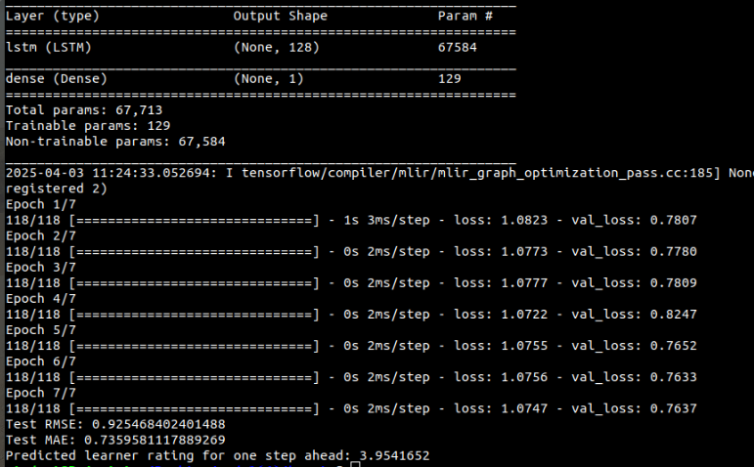
BEFORE AND AFTER TRANSFER LEARNING(MODEL-4)

Slide 37
FUTURE WORK
Feedback-Driven Adaptation Integrate user or system feedback to further fine-tune models in real-time.
Expand to More Domains Test transfer learning across additional real-world educational datasets and learning tasks.
Model Compression & Optimization Explore pruning, quantization, or knowledge distillation to further reduce inference time.
Hybrid Recommender Architectures Combine collaborative filtering with deep learning and transfer learning for robust recommendations.

Slide 38
CONCLUSION
Our efficient educational recommender system utilizes transfer learning to significantly enhance accuracy and reduce training/testing time in course recommendations.
By leveraging knowledge from related domains, transfer learning addresses key challenges data sparsity, enabling the system to deliver more relevant recommendations even with limited data.
By effectively integrating transfer learning, the project demonstrates the potential to boost the performance of educational recommender systems, making learning experiences more personalized and impactful.

Slide 39
REFERENCES
X. Fang, “Making recommendations using transfer learning,” Neural Comput. Appl.,vol. 33, no. 15, p. 9663–9676, Aug 2021.
M. Weber, M. Auch, C. Doblander, P. Mandl, and H.-A. Jacobsen, “Transfer Learning With Time Series Data: A Systematic Mapping Study,” IEEE Access, vol. 9, pp. 165409–165432, 2021.
Khalid, A., Lundqvist, K., Yates, A., & Ghzanfar, M. A. (2021). Novel online Recommendation algorithm for Massive Open Online Courses (NoR-MOOCs). PLOS ONE, 16(1), e0245485.
M. Zhang, S. Wu, X. Yu, Q. Liu, and L. Wang, “Dynamic Graph Neural Networks for Sequential Recommendation,” IEEE Transactions on Knowledge and Data Engineering, pp. 1–1, Jan. 2022.

